Slide 1

Covid-19 Data
Extraction
Transformation
Loading
Visualization
Sandesh Kandel | Intern

Slide 2





Tech Stack Used

Slide 3
Fetching Covid-19 Statistical Data
Retrieves global COVID-19 statistics data from an API and processes it to save in a CSV file
Import required Python modules: requests, json, csv
Define API endpoint URL and headers (including API key and host)
Send GET request to API endpoint using requests.get()

Slide 4
Data Transformation and Cleaning
Importing necessary modules (csv and ast) and defining input/output file paths
Extracting country names from 'location' column and storing in a list
Updating 'location' column in input CSV with extracted country names and writing to output CSV

Slide 5
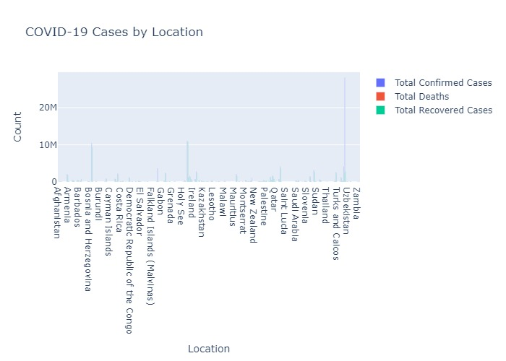
Data Visualization and Analysis
Bar Chart Visualizations
Total cases/deaths/recoveries per location

Slide 6
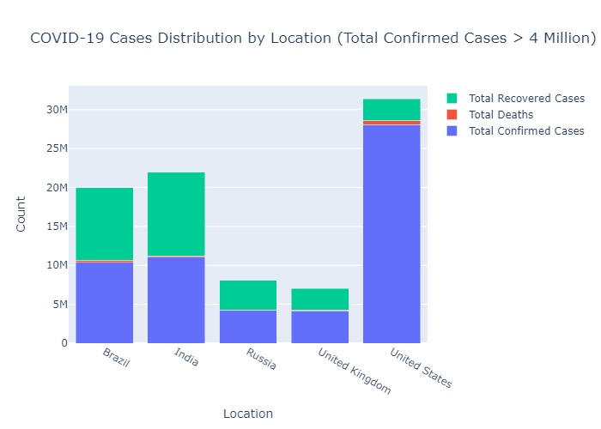
Locations with over 4 million cases (stacked)

Slide 7
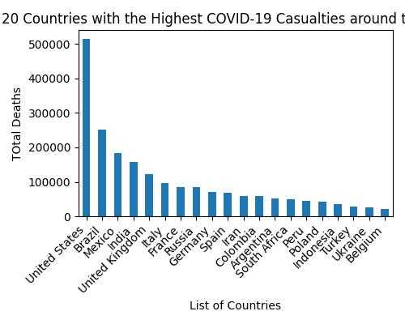
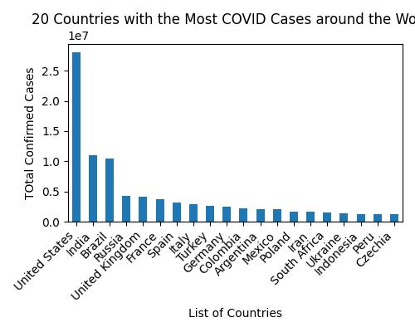
Top 20 Countries Analysis
Bullet points on bar charts showing:
Top 20 Countries by Casualties
Top 20 countries by cases

Slide 8
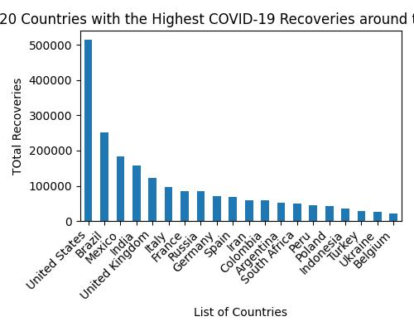
Top Countries 20 by Recoveries

Slide 9
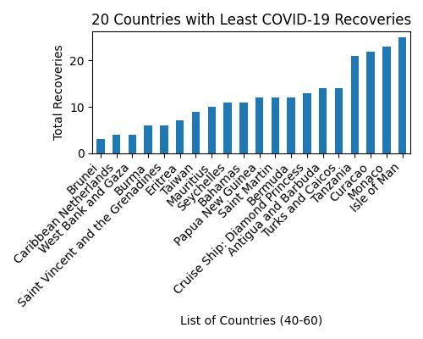
Top Countries 20 by Least Recoveries

Slide 10
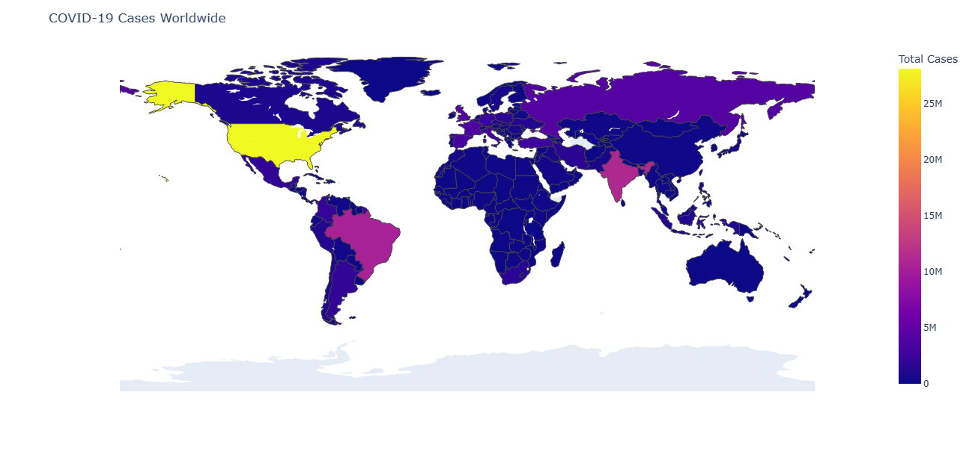
World Choropleth Map

Slide 11
Connecting to MySQL Database
Establishing connection to MySQL database using predefined credentials
Reading data from 'modified_data.csv' file and storing it in a list
Creating 'covid_info' table and inserting CSV data into MySQL database using SQL queries

Slide 12
Interactive Covid-19 Dashboard with User Authentication
Flask web application serving as a dashboard to visualize COVID-19 data, with MySQL as the backend for user authentication
User registration ('/register') and login ('/login') functionality with password hashing and session management
Rendering COVID-19 visualizations (images, interactive world map) on the dashboard ('/') and dedicated routes ('/world_map')

Slide 13
Thank You!

